Slide 1
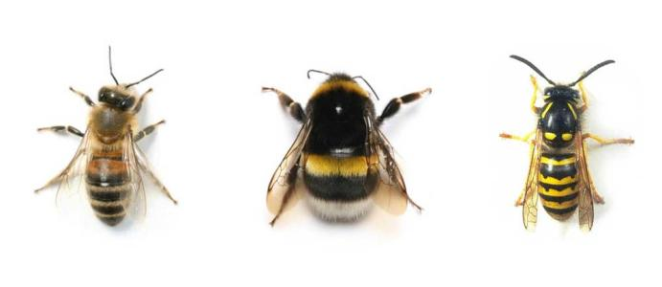
Bees AT CRAMOND: Safety and protecting them

Slide 2
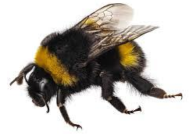
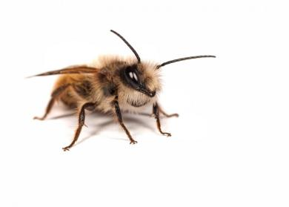
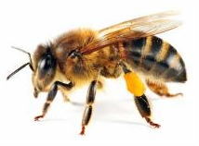
At Cramond Primary, we are lucky enough to have many bees that live on our playground! Maybe you’ve seen some of them! Below are a few that P3I has seen and identified.
Bumble Bees
Mason Bees
Honey Bees

Slide 3
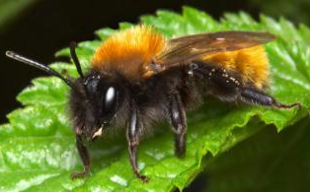
You may have noticed bees on the playground, near the log steps and rocks. They are called mason bees. They will not hurt you, and they are important pollinators! They are a type of solitary bee (they don’t build nests, but burrow holes). Mason bees look like this:

Slide 4
Our topic this term in P3 is Minibeasts.
We’ve been studying bees, and how important
they are for our environment. We have
noticed that many children and parents seem
to be frightened of the mason bees that are
near the log steps, and we want to tell you
not to afraid!

Slide 5
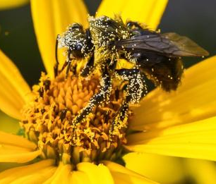
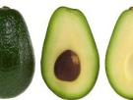
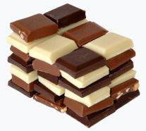
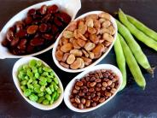
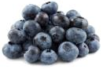
Why do we need bees?
Bees are pollinators! Plants
need help to grow, breed, and
produce food. Humans need
food! 30% of the world’s crops and 90%
of wild plants need pollinators (bees) to thrive!
Without bees, we wouldn’t have a lot of foods.
Here are a just few that would disappear
without bees:

Slide 6
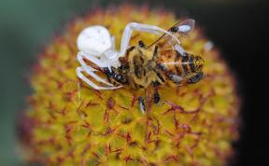
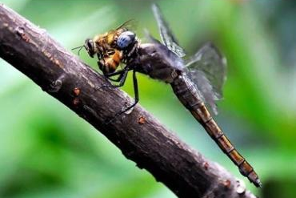
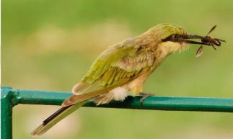
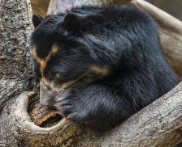
Why do we need bees?
Biodiversity (lots of different plant and
animal life in the world) makes the world a
healthy place. Loads of other plants
and animals rely on having bees in their habitat
to live!
Badgers, foxes,
bears, mice, and
other animals eat
entire nests –
bees and all!
The Crab Spider
The Bee-Eater
Dragonflies

Slide 7
Bees are in danger!
Bee colonies are collapsing
and wild honey bee
populations in North America
and Europe are in decline.
Why is this?
Changes in farming practices. Wildflower
meadows have been ploughed up to make space
for fields. (Bees need wildflowers!)
2. Pesticide use (the chemicals we put on plants
to make them grow) has increased massively.
3. People are trading bees around the world and
spreading diseases.

Slide 8
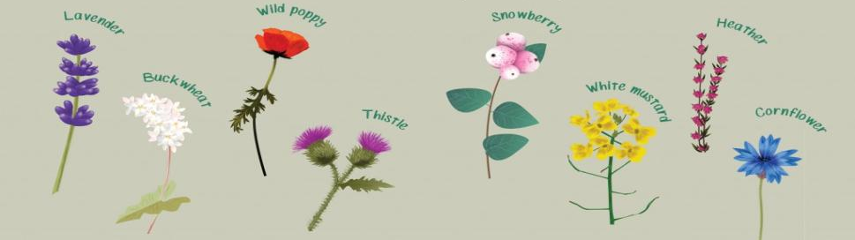
How can we safely live with bees and protect them?
Leave bees and wasps alone. If you leave
them alone, they will leave you alone.
2. Don’t swat or stomp on a bee.
3. Plant nectar and pollen rich flowers! Bees love the flowers below.
4. Leave areas of your garden undisturbed to build a nest. Or build a bee hotel for them!
5. Raise awareness about protecting bees.

Slide 9
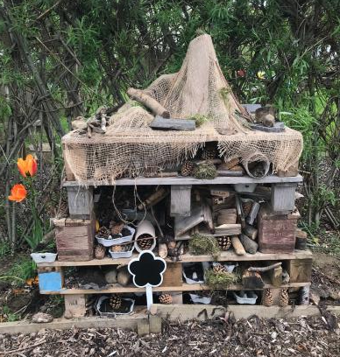
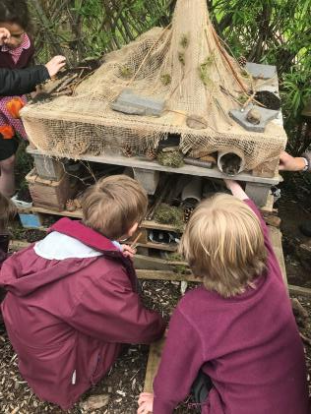
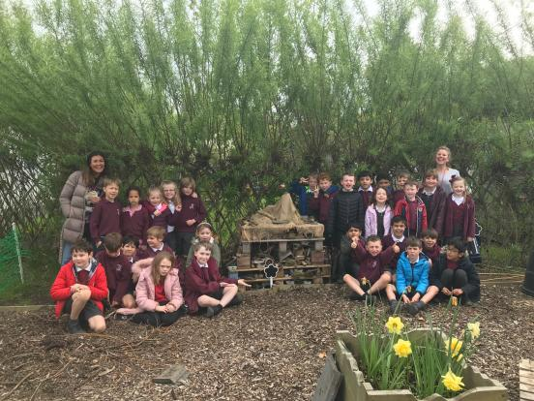
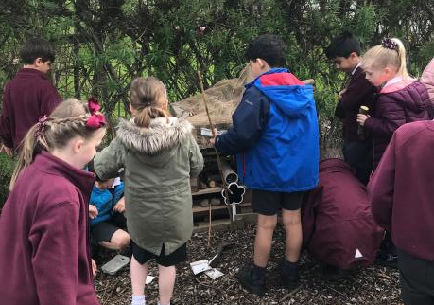
P3 Built
Bee and
Bug
Hotels!

Slide 10
Thank you for
watching our
sentation.
Protect our bees!
#CRAMONDCARES

